Slide 1
Solid waste & its types

Slide 2

Waste is defined as any unwanted or useless materials.
OR
Waste is any substance which is discarded after primary use, or it is worthless, defective and of no use.

Slide 3
Solid waste
Liquid waste
Gaseous waste
Animal by product(ABPs)
Biodegradable waste
Chemical waste
Commercial / Business waste
Biomedical waste
Bulky waste

Slide 4

It is defined as
“ non liquid, non-soluble materials ranging from municipal garbage to industrial wastes that contain complex & sometimes hazardous substances”.
Solid waste refers to the range of garbage arising from animal and human activities that are discarded as unwanted and useless.

Slide 5
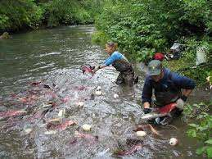

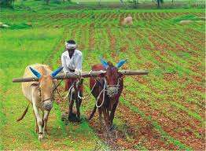
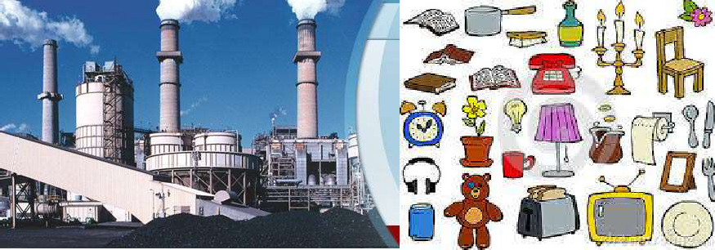
Agriculture
Fisheries
Household
Commerce and industry

Slide 6
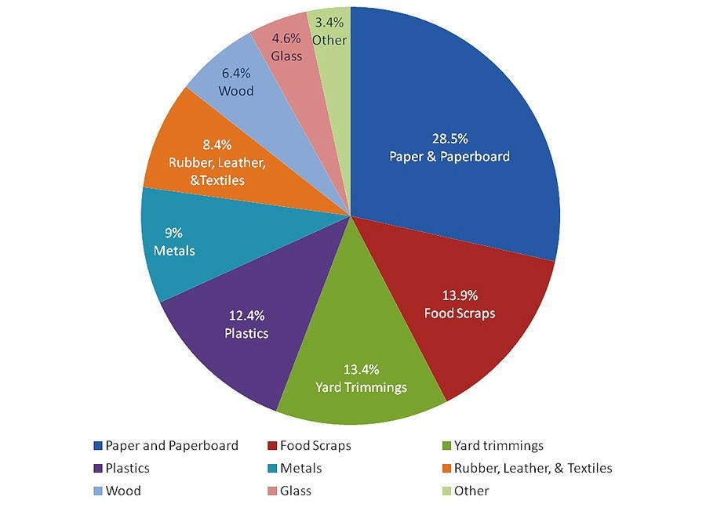
Types of Solid Wastes

Slide 7

Broadly there are 3 types of waste which as follows
Household waste as municipal waste
Industrial waste as hazardous waste
3. Biomedical waste or hospital waste as infectious waste

Slide 8
Municipal solid waste consist of--- household waste construction and demolition debris sanitation residue waste from streets.
With rising urbanization and change in life style and food habits, the amount of municipal solid waste has been increasing rapidly and its composition changing.

Slide 9



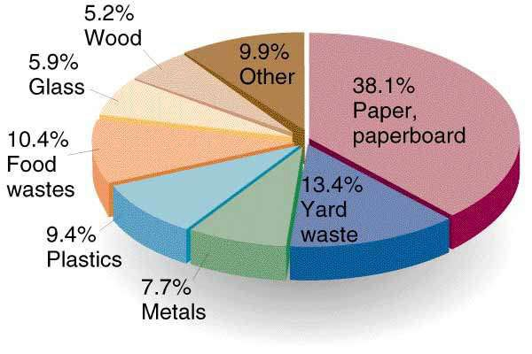

Slide 10
Industrial and hospital waste is considered hazardous as they may contain toxic substances
Hazardous waste could be highly toxic to humans, animals and plants. They are
  corrosive
  highly inflammable or explosive
In the industrial sector the major generators of hazardous waste are the metal, chemical, paper, pesticide, dye and rubber goods industries.
Direct exposure to chemicals in hazardous waste such as mercury and cyanide can be fatal.

Slide 11

Bio-medical waste means “Any waste which is generated during the diagnosis, treatment or immunization of human beings or animals or in research activities pertaining there to or in the production or testing of biological” -Bio-medical waste rules ,1998
It may includes wastes like sharp waste, pathological waste, pharmaceutical waste etc.

Slide 12
If solid waste are not collected and allowed to accumulate , they may create unsanitary conditions.
Exposure to hazardous waste can affect human health, children being more vulnerable to these pollutants.
Many diseases like cholera. Diarrhea, dysentery, plague, jaundice, or gastro- intestinal diseases may spread and cause loss of human lives.

Slide 13


In addition improper handling of the solid wastes, a health hazard for the workers who come in direct contact with the waste.
Environmental impact
If the solid wastes are not treated properly decomposition and putrefaction (decay) may take place.
The organic solid waste during decomposition may generate obnozious (intolerable odour).

Slide 14
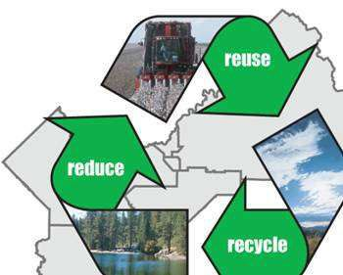
The 3Rs (Reduce, Reuse, Recycle) to be followed for waste management.

Slide 15

Disposable goods: paper plate, paper bowl, Styrofoam cup, plastic spoon, roll of paper towels, paper napkin;
Durable goods: ceramic/plastic plate, metal spoon, glass/plastic drinking cup, dish towel, cloth napkin)
Recovery of one tonne paper can save 17 trees.

Slide 16

Instead of buying new containers from the market, use the ones that are in the house.
Don’t through away the soft drink can or bottle cover them with home made paper or paint on them and use them as pencil stands or small vases.

Slide 17


Use shopping bags made of cloth or jute which can be used over and over.

Slide 18
Incineration
Incineration is a disposal method in which solid organic wastes are subjected to combustion so as to convert them into residue and gaseous products.
This method is useful for disposal of residue of both solid waste management and solid residue from waste water management.
This process reduces the volumes of solid waste to 20 to 30 percent of the original volume.

Slide 19
Incineration is carried out both on a small scale by individuals and on a large scale by industry. It is used to dispose of solid, liquid and gaseous waste.
It is recognized as a practical method of disposing of certain hazardous waste materials (such as biological medical waste).
Incineration is a controversial method of waste disposal, due to issues such as emission of gaseous pollutants.

Slide 20
Landfill
A landfill site is a site for the disposal of waste materials by burial and the oldest form of waste treatment.
Historically, landfills have been the most common method of organized waste disposal and remain so in many places around the world.

